Slide 1

{% A.C.A. Team %}

Slide 2

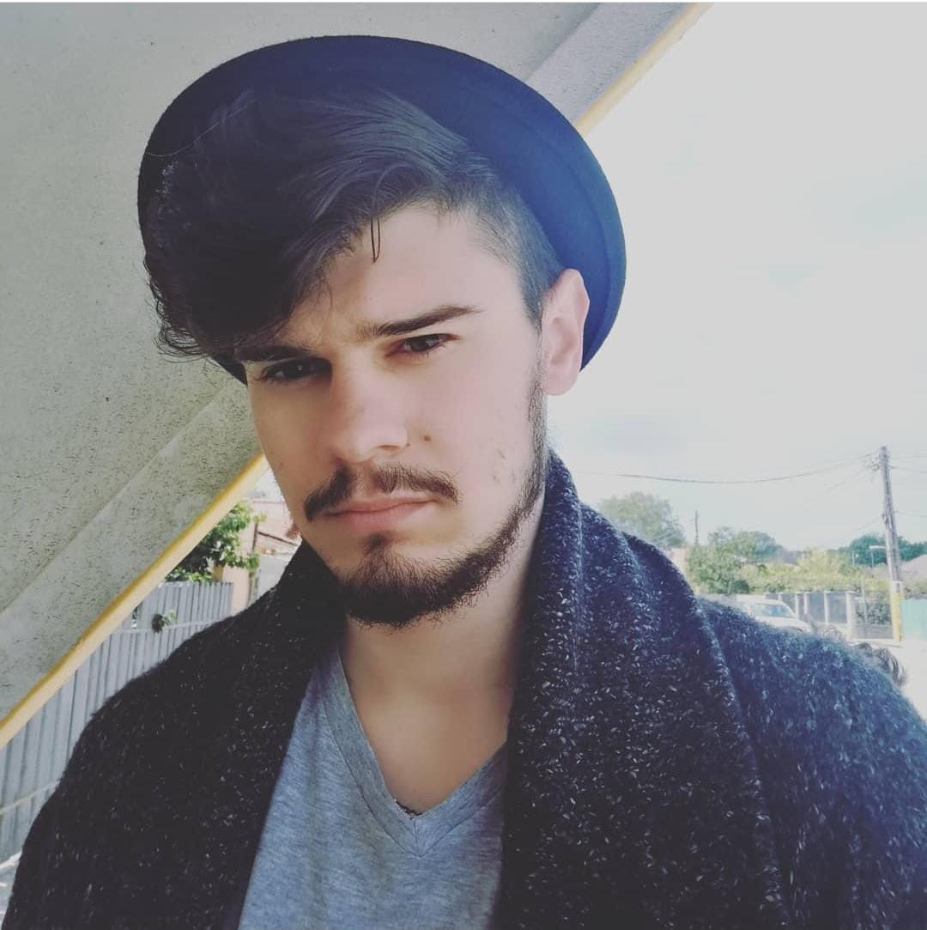
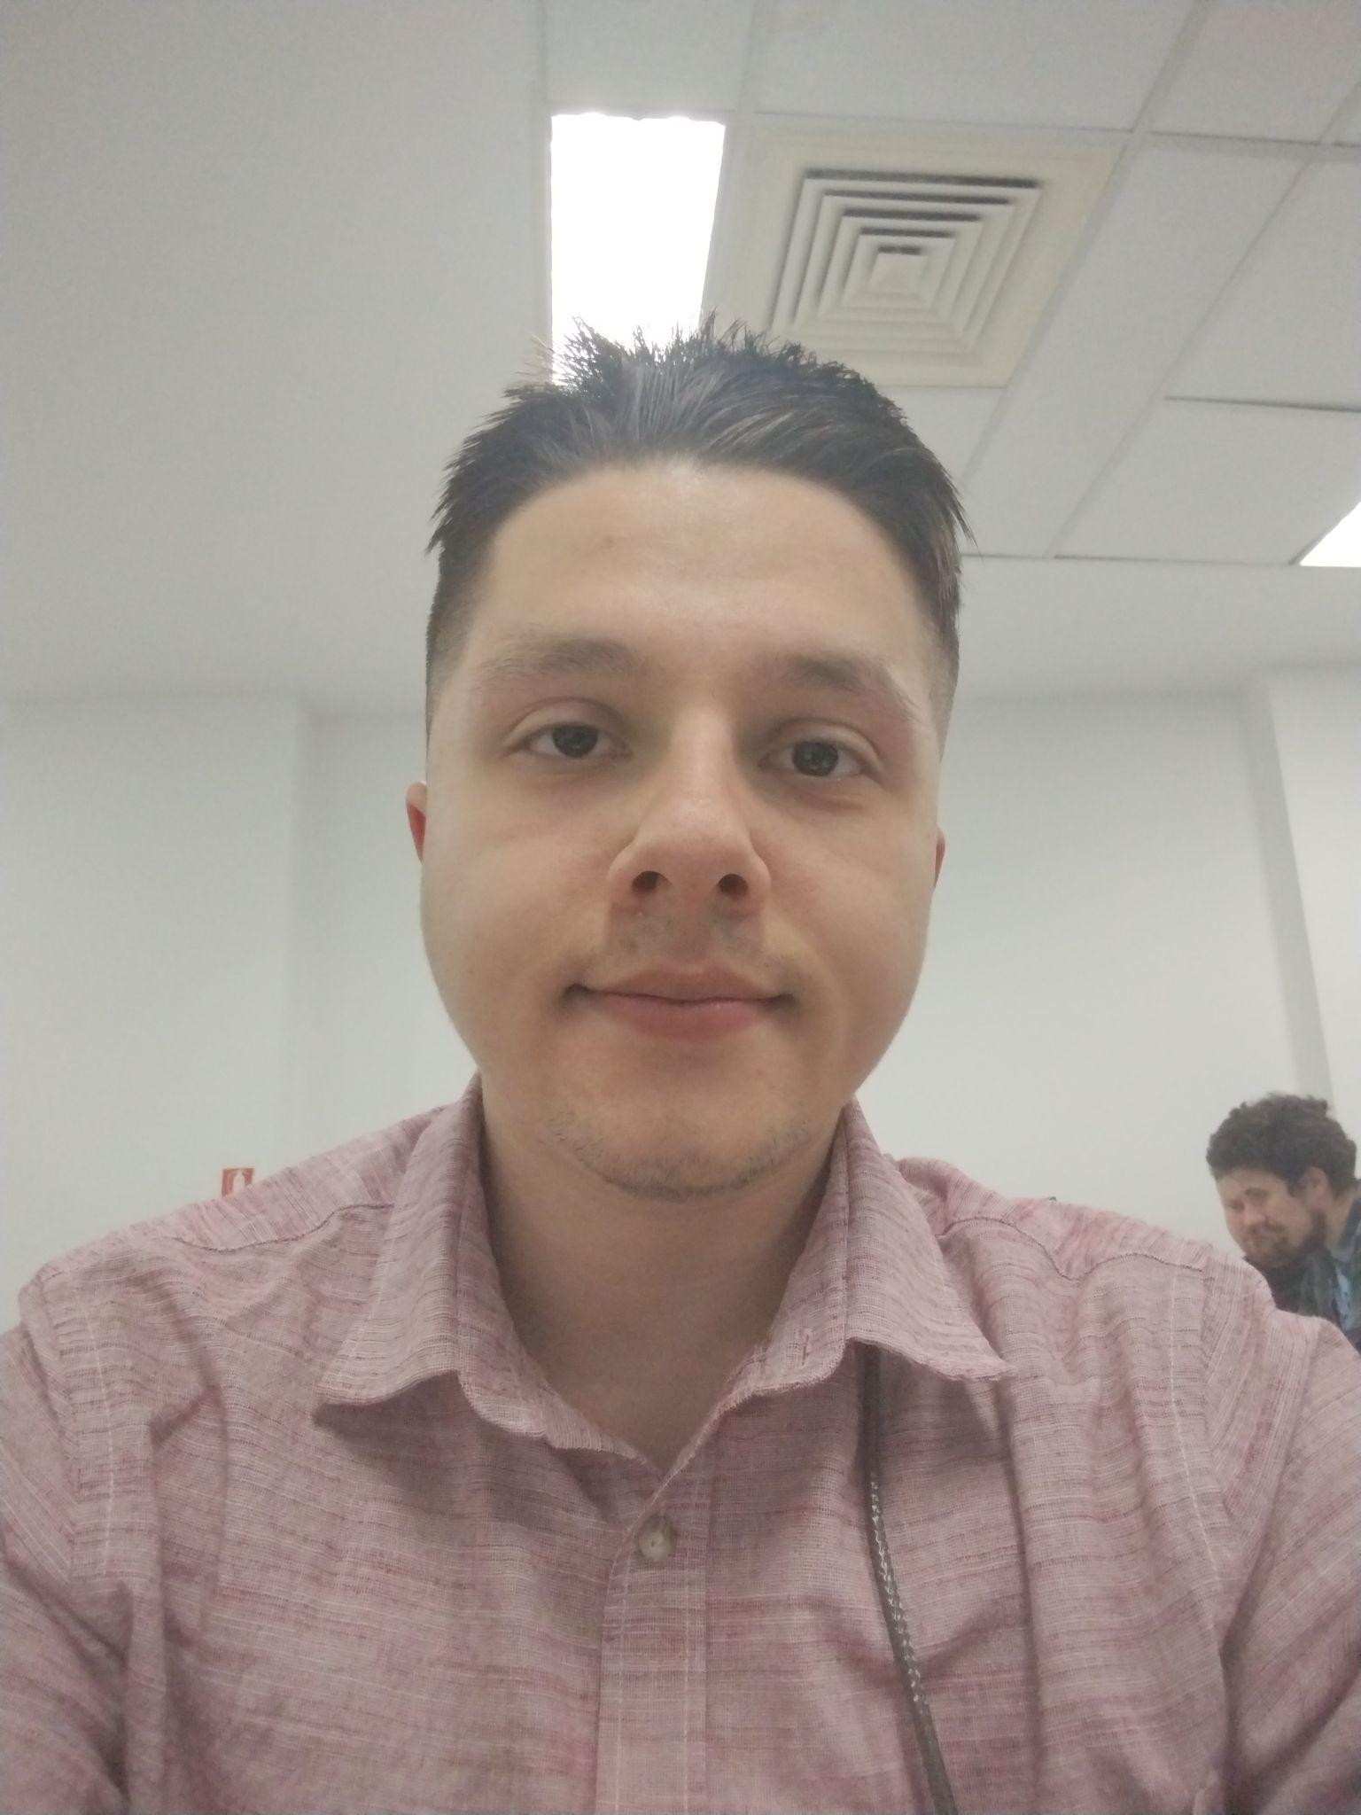
<div class="box-container">
A.
My name is Andrei Alexandru,
I’m 24 years old and have been coding
for about 6 months, being a newly discovered passion.
"{{ url_for('static', filename='SmileLogo.jpg')}}"
C.
My name is Claudiu Olaru,
I’m 26 years old and in the past 6 months I have returned to an older passion of mine.
<input type="text" placeholder="personal-information">
A.
My name is Alex Dumitru,
I’m 21 years old and I made a huge step in my life when joining
CodeCool.
</div>

Slide 3
INFOGRAPHIC
Final step
First Step
Profitable Product
Your doctor will prescribe you the appropriate medication or if required, he will recommend that you go to the hospital for treatment.
Create an account and fill out your personal information.
Business Succesfully
Circle Mission
Step by Step
Second step
Third step
Meet your doctor and discuss your symptoms with him.
Choose your date and time for your virtual consultation with one of our doctors.

Slide 4

“
What People Said
`I have been using this app for the last few weeks and I am amazed at how much time I have saved so far with my online consultations. The competency of the staff was awe inspiring. I could not have been luckier to have you caring for me at such a difficult time.`

Slide 5
OUR SERVICE
Usability
Our application is very intuitive and easy to use for our customers.
Improvement
Business
We are constantly looking for new features to implement into our application.
Our market is growing year on year, and with future investment there is a huge opportunity for scaling.
Security
Our patient’s personal information is completely secure, due to our encryption systems we have in place.

Slide 6
Where Compassion and Healing Come Together.
2,351
12,454
4.24
52,681
Specialist Doctors
Healthy Customers
Average time saved for our patients (in hours)
Total time saved for our patients (in hours)
To inspire hope and contribute to health and well-being by providing the best care to every patient through integrated clinical practice, education and research.

Slide 7
Thank you for your attention.
Please feel free to ask any questions you may have!

